Slide 1
Budgetary Affairs Committee Report
Faculty Senate Meeting
March 24, 2017

Slide 2
Budgetary Affairs Committee (BAC)
Budget Task Force
(6 faculty members, 4 administrative members, Student member(s))
Administrative Budget Task Force
(6 administrative members, 4 faculty members, Student member(s))
Joint task forces met two times
Discussed Budget Reduction Proposal

Slide 3
Issues/Concerns:
Budget Reduction Scenario
$4.6M in reductions
$20M is “set aside”
5% Sponsored Programs reduction
$500K in Lab Improvement Reduction
Misc. Instruction not funded
$569K IT Reduction (IT fee issue?)

Slide 4
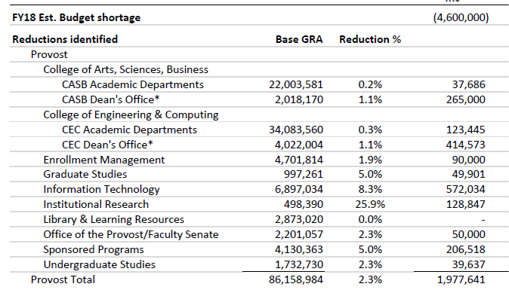

Slide 6
